Slide 1
CSCI 561 Foundations of
Artificial Intelligence Lecture 1: Overview and Background (Chapter 1 & 2)
FALL 2018
INSTRUCTOR: PROF. SHEILA TEJADA

Slide 2
What is Artificial Intelligence (AI)?
Some problematic definitions
“The study of how to make computers do things at which, at the moment, people are better.” (E. Rich & K. Knight)
“The concept of making computers do tasks once considered to require thinking.”
The use of logic or rules or … to solve problems on computers.
“An algorithm by which the computer gives the illusion of thinking like a human.” (D. Gruber)
“Making computers behave like humans.” (Webopedia)
Notes:
A perverse definition: Scientific progress may weaken the field

Slide 3
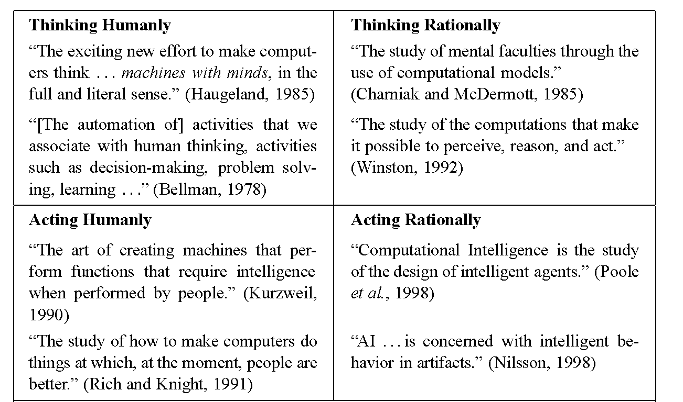
What is Artificial Intelligence? Four views
Like People
Rationally
Think
Act
Notes:
A perverse definition: Scientific progress may weaken the field

Slide 4
A Synthesis Definition
“The scientific understanding of the mechanisms underlying thought and intelligent behavior and their embodiment in machines.” (AAAI)
AI overlaps strongly with Cognitive Science and its various subdisciplines, but also relates to:
Mathematics: Formalizations and analysis
Economics: Decision making
Operations research: Optimization and search
Engineering: Robotics

Slide 5
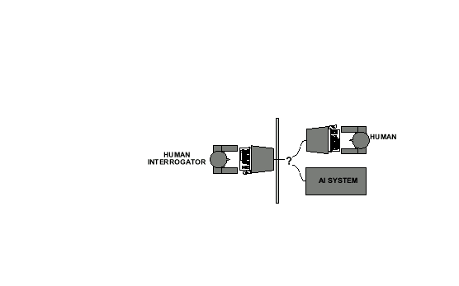
The Turing Test
Alan Turing's 1950 article Computing Machinery and Intelligence discussed conditions for considering a machine to be intelligent
“Can machines think?” ←→ “Can machines behave intelligently?”
The Turing test (The Imitation Game): Operational definition of intelligence.

Slide 6
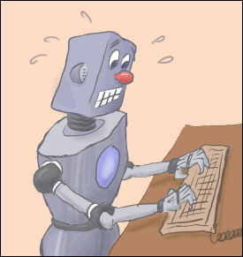
The Turing Test
Computer needs to possess: Natural language processing, Knowledge representation, Automated reasoning, and Machine learning
Are there any problems/limitations to the Turing Test?

Slide 7
The Turing Test (Problems)
Problems:
1) Turing test is not reproducible, constructive, or amenable to mathematic analysis.
2) Subject to “tricks”

Slide 8
The Turing Test (Problems)
Problems:
1) Turing test is not reproducible, constructive, or amenable to mathematic analysis.
2) Subject to “tricks”
3) What about physical interaction with interrogator and environment?

Slide 9
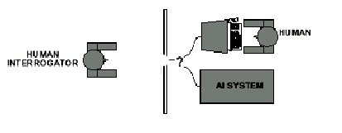
The Full Turing Test
Problems:
1) Turing test is not reproducible, constructive, or amenable to mathematic analysis.
2) Subject to “tricks”
3) What about physical interaction with interrogator and environment?
Trap door

Slide 10

What would a computer need to pass the Turing test?
Natural language processing: to communicate with examiner.
Knowledge representation: to store and retrieve information provided before or during interrogation.
Automated reasoning: to use the stored information to answer questions and to draw new conclusions.
Machine learning: to adapt to new circumstances and to detect and extrapolate patterns.

Slide 11
What would a computer need to pass the Turing test?
Vision (for Total Turing test): to recognize the examiner’s actions and various objects presented by the examiner.
Motor control (total test): to act upon objects as requested.
Other senses (total test): such as hearing, smell, touch, etc.

Slide 12
Some Examples

Slide 13
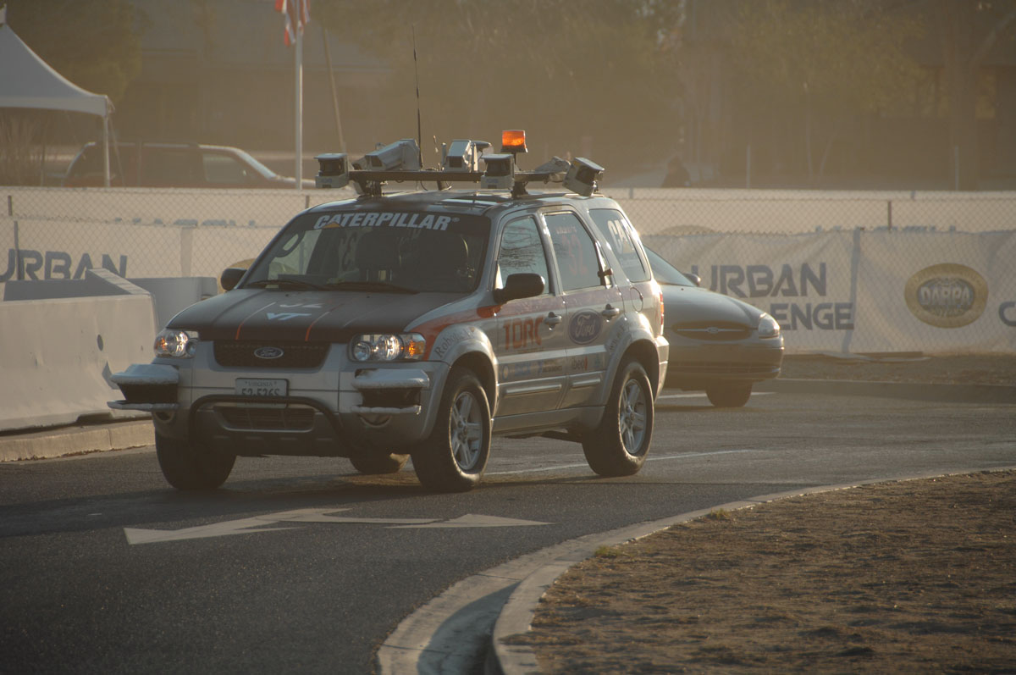
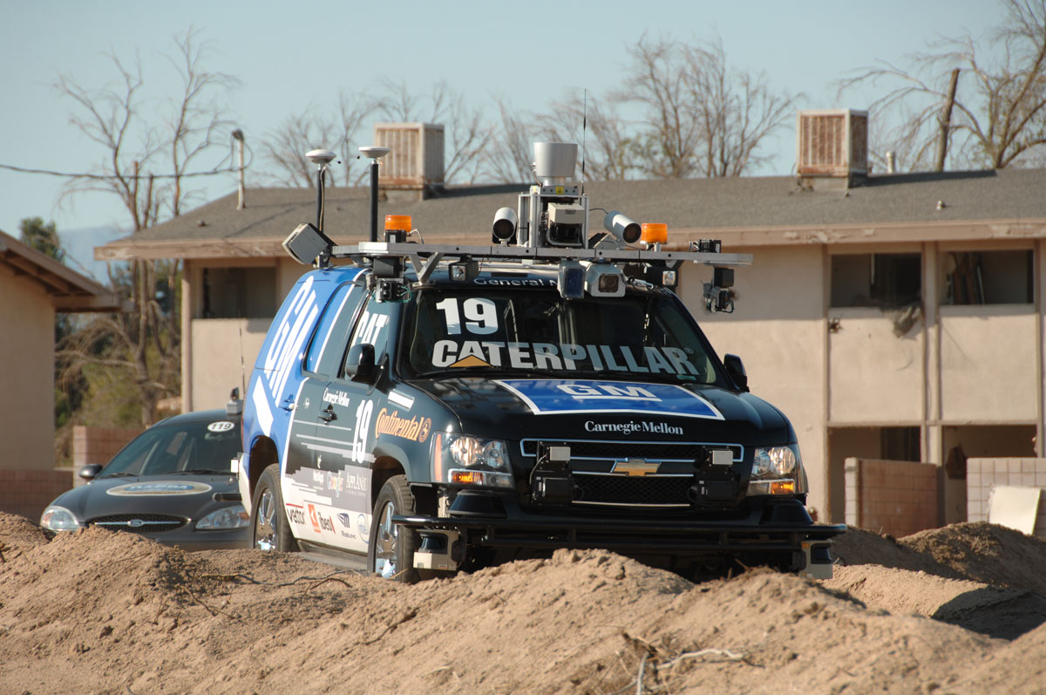
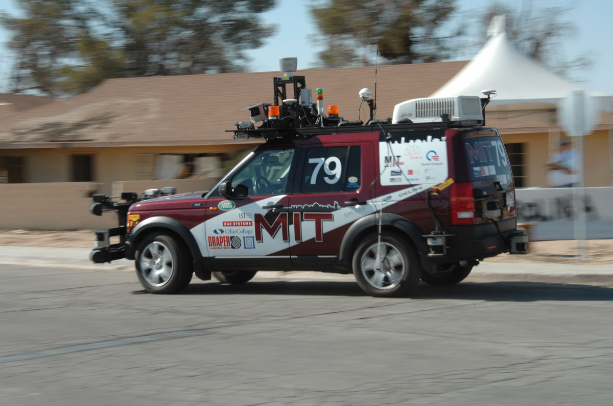
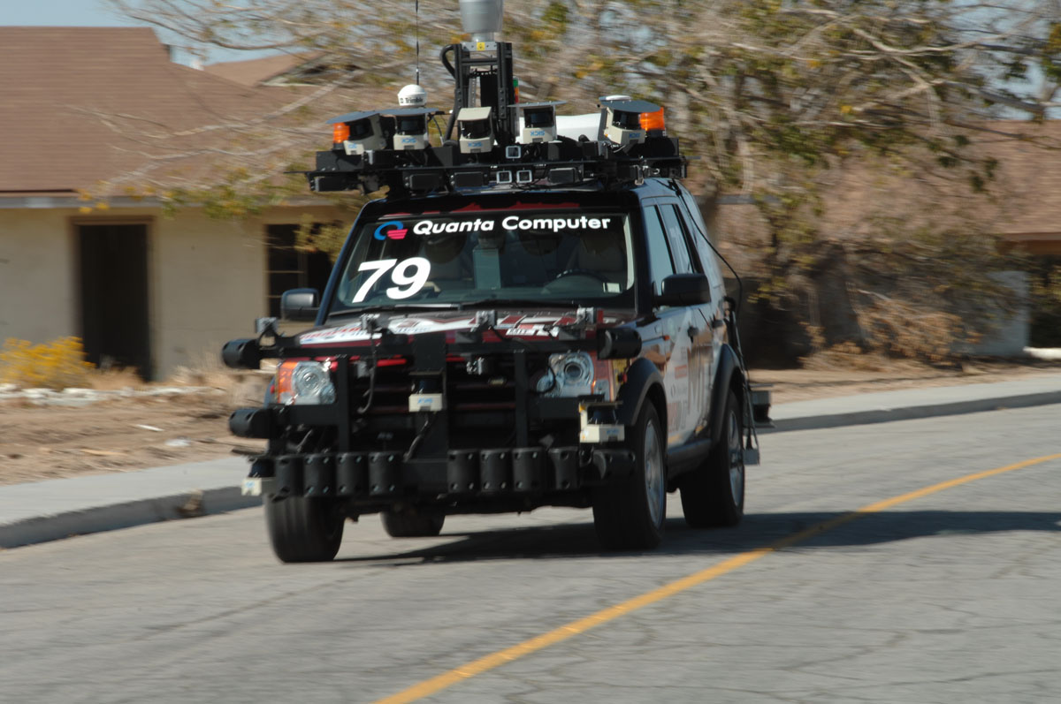
DARPA Urban Challenge (2007)
“Autonomous vehicles that safely execute missions in a complex urban environment with moving traffic.”
“The objective of this program is safe and correct autonomous driving capability in traffic at 20 mph.”

Slide 14
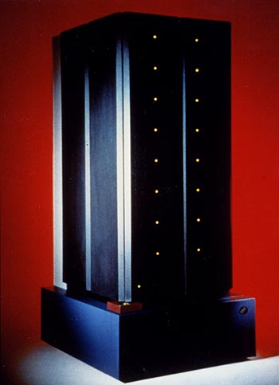
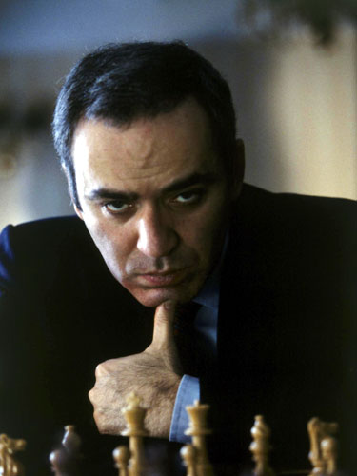
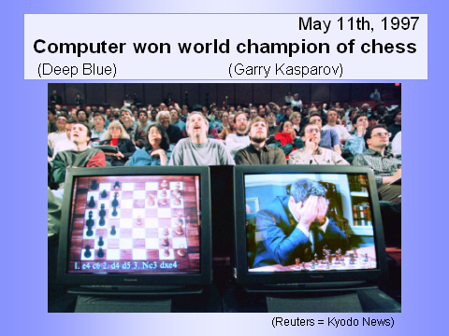
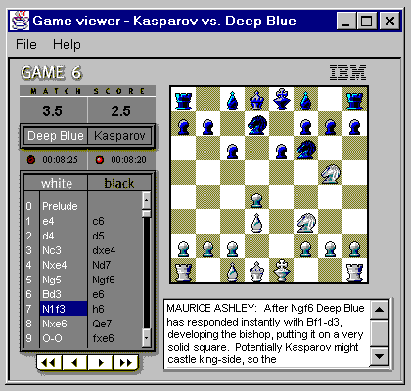
Deep Blue
In 1997 Deep Blue became the first machine to win a match against a reigning world chess champion (by 3.5-2.5)

Slide 15
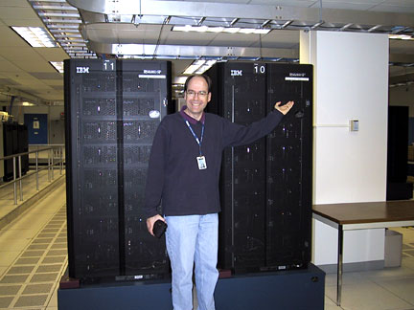
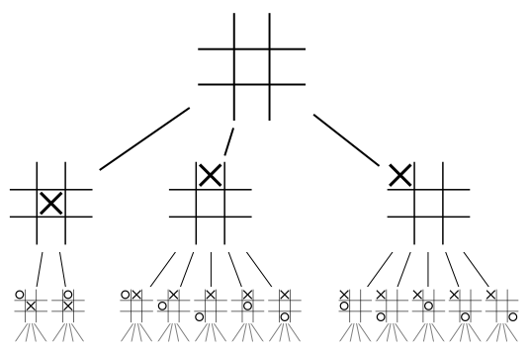
Deep Blue Combined
Parallel and special purpose hardware
A 30-node IBM RS/6000, enhanced with
480 special purpose VLSI chess chips
A heuristic game-tree search algorithm
Capable of searching 200M positions/sec
Searched 6-12 moves deep on average, sometimes to 40
Chess knowledge
An opening book of 4K positions and 700K GM games
An endgame database for when only 5-6 pieces left
A positional evaluation function with 8K parts and many parameters that were tuned by learning over thousands of Master games

Slide 16
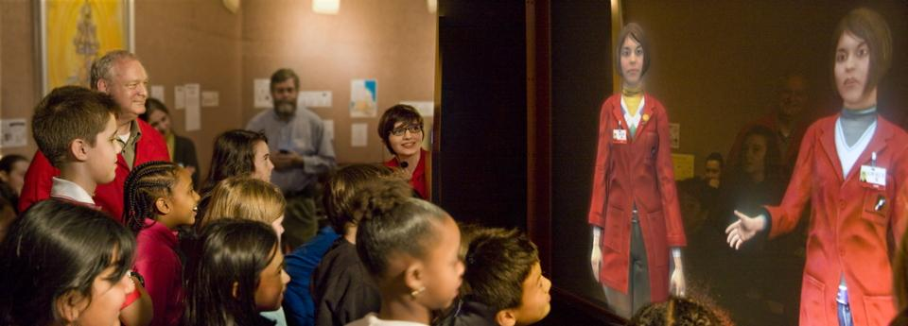

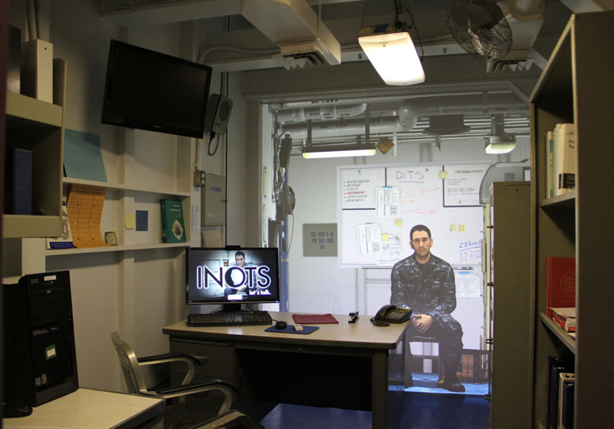

Example Virtual Humans (USC/ICT)
Ada & Grace
Gunslinger
INOTS
SASO
Notes:
Show a bit of SASO and then Ada & Grace

Slide 17

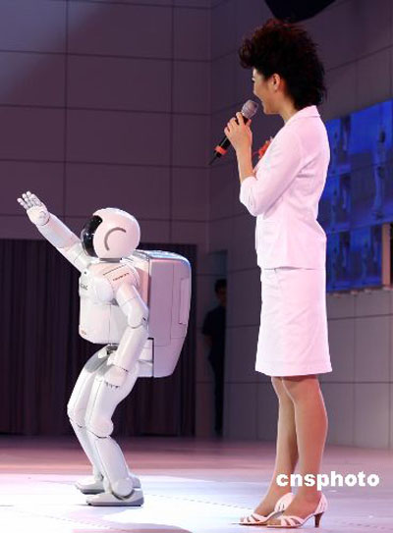
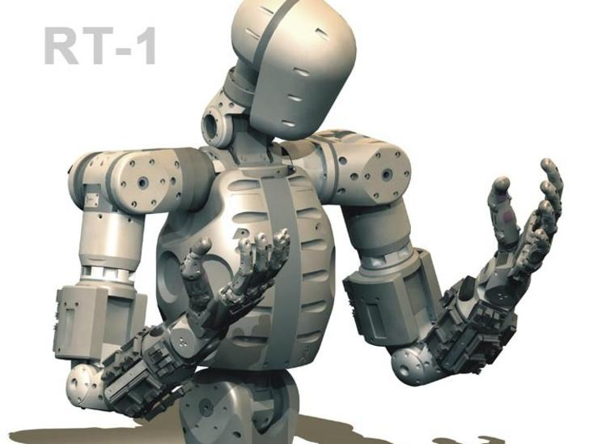
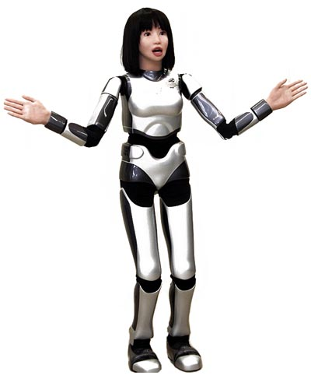
Grand Challenges for AI
Human-level AI
Intelligent virtual humans
Humanoid robots
Superhuman performance in limited domains
Beat the world champion at chess (or Go)
Effective control of very complex systems
Specific advanced capabilities of interest
Mathematical or scientific discovery
Automatically drive a vehicle in real world
Answer a wide range of questions
Autonomously behave & learn continuously over years
Automated real-time language and speech translation
Learn to perform a new task from scratch
Notes:
Italicized things we’ve seen

Slide 18
CSCI 561: Artificial Intelligence
Course overview: foundations of symbolic intelligent systems. Agents, search, problem solving, logic, representation, reasoning, symbolic programming, and robotics.
Prerequisites: Good programming and algorithm analysis skills. Basic probability theory desirable.
Exams: 8:00pm – 9:50pm on Mondays September 24, October 29, and November 26
Textbook:
Russell & Norvig, Artificial Intelligence: A Modern Approach

Slide 19
CSCI 561: Artificial Intelligence
Professors
Sheila Tejada, PhD (stejada@usc.edu)
Wei-min Shen, PhD (shen@isi.edu)
Ning Wang, PhD (discussions) (nwang@ict.usc.edu)
Teaching Assistants
Elizabeth Bondi - bondi@usc.edu
Joseph Chen - chianc@usc.edu
Thomas Collins - collinst@usc.edu
Maxwell Johnson - maxwelsj@usc.edu
Daniel Link - dlink@usc.edu
John Tran - johntran@usc.edu

Slide 20
CSCI 561: Artificial Intelligence
Grading
Grades for this course will be based on performance on homework and exams.
Homework: 25%, 3 assignments (5%,10% 10%)
Exams: 75%, 3 exams at 25% eaach

Slide 21
CSCI 561: Artificial Intelligence
Grading
Final letter grades for this course are entirely at the discretion of the course professor. Based on previous semesters, we expect that letter grades for this course will follow this scale:
85% or higher : A
80-85% : A-
75-80% : B+
70-75% : B
65-70 : B-
60-65% : C+
55-60% : C
50-55% : C-

Slide 22
CSCI 561: Artificial Intelligence
More on Homework Assignments
There will be three homework assignments, which may consist of programming problems, open-ended essay questions, and questions representative of those that will appear on course exams.
Programming problems may require the use of a specific programming language, e.g. Python.
Programming assignments will be corrected and checked for cheating by automated agents.

Slide 23
CSCI 561: Artificial Intelligence
Learning Management System
This course will make extensive use of the online learning management system, DEN@Viterbi. Students will submit all homework assignments via this system. This system will also be used to provide online discussion forums where students can discuss topics with their peers, the teaching assistant, and course instructors. DEN@Viterbi can be found online at: https://courses.uscden.net/d2l/login

Slide 24
Academic Integrity
Familiarize yourself with the USC Academic Integrity guidelines.
Violations of the Student Conduct Code will be filed with the Office of Student Judicial Affairs, and appropriate sanctions will be given.
Homework assignments are to be solved individually.
You are welcome to discuss class material in review groups, but do not discuss how to solve the homeworks.
Exams are closed-book with no questions allowed.

Slide 25
Academic Integrity
All students are responsible for reading and following the Student Conduct Code. Note that the USC Student Conduct Code prohibits plagiarism.
Some examples of what is not allowed by the conduct code: copying all or part of someone else's work (by hand or by looking at others' files, either secretly or if shown), and submitting it as your own; giving another student in the class a copy of your assignment solution; or consulting with another student during an exam.
=> If you have questions about what is allowed, please discuss it with the instructor.
Students who violate university standards of academic integrity are subject to disciplinary sanctions, including failure in the course and suspension from the university. Since dishonesty in any form harms the individual, other students, and the university, policies on academic integrity will be strictly enforced. Violations of the Student Conduct Code will be filed with the Office of Student Judicial Affairs.

Slide 26
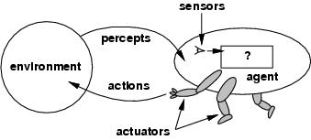

Agents and Environments
Agents are systems that perceive and act in some environment
Including humans, robots, softbots, thermostats, etc.
Ignore Knowledge & Goals for now
Environment is world in which agent operates
Knowledge
Goals
Vacuum-Cleaner World
Notes:
K&G are part of intelligent agents

Slide 27
Cognitive Cycle
Agent repeatedly decides what to do next
The cognitive cycle that repeats for agent lifetime
In humans, the cycle runs at ~50-100ms
This is minimum time to choose an action, but many such cycles can be combined to make harder choices
On each cycle, agent can be considered to be computing a function for decision making
Perception
Memory Access
Decision
Learning
Action

Slide 28
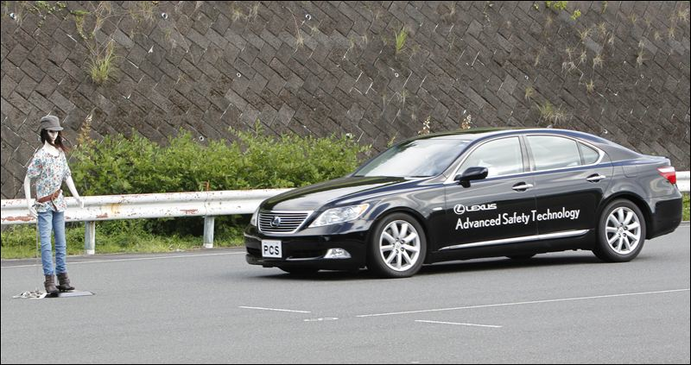
Agent Function
The agent function is a mathematical relationship that maps percept sequences to actions in the environment
f: P* >A
For example:
[A, Dirty] > SUCK
[Car 20’ away][Car 10’ away] > RUN

Slide 29
From Agent Functions to Agent Programs
The agent function is computed by an agent program
The agent program runs on the physical architecture to implement the function
I.e., generates actions from percept sequences

Slide 30
The Vacuum-Cleaner World
Environment: squares A and B
Percepts: [Location, Content] e.g. [A, Dirty]
Actions: left, right, suck, and no-op
Notes:
For this lecture, we’ll look at agents and their programs in the context of a simple world.

Slide 31
A Table-Based Agent Program
Percept sequence | Action
[A,Clean] | Right
[A, Dirty] | Suck
[B, Clean] | Left
[B, Dirty] | Suck
[A, Clean],[A, Clean] | Right
[A, Clean],[A, Dirty] | Suck
… | …
This Blows Up as Time Goes On
Notes:
An example, but very tedious way to write, and infinite!
Will clearly need means of generalizing/compressing

Slide 32
Rationality & Rational Agents
What is rational at a given time depends on:
Performance measure
Ideally objective, external, based on what is to be achieved
Prior environment knowledge
Actions
Percept sequence to date (sensors)
A rational agent chooses whichever action maximizes the expected value of the performance measure given the percept sequence to date and the prior environment knowledge

Slide 33
What Rationality Isn’t
Generality, literacy, autonomy or collaboration
Omniscience
An omniscient agent knows what will occur
Perfection
Rationality maximizes expected (prospective) performance, while perfection maximizes actual (retrospective) performance

Slide 34
Environments
Environment: World in which the agent operates
To understand agent behavior - or to design a special purpose agent - need to understand its environment
Simon’s Ant: Complex behavior may arise from a simple program in a complex environment
Rationality defined, at least in part, in terms of agent’s environment
PEAS description of the task environment:
Performance: Measure for success/progress/quality
Environment: The world in which the agent operates
Actuators: How the agent affects the environment
Sensors: How the agent perceives the environment

Slide 35
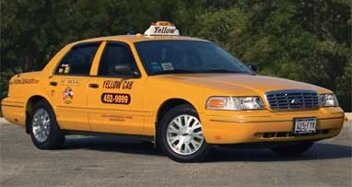
Example: Automated Taxi
Performance
Safety, destination, profits, legality, comfort, …
Environment
Streets/freeways, other traffic, pedestrians, weather, …
Actuators
Steering, accelerating, braking, horn, speaker/display,…
Sensors
Video, sonar, speedometer, engine sensors, keyboard, GPS, laser rangefinder, audio…

Slide 36
The Agent-Environment Boundary
Where draw boundary?
Does agent include just agent program
Or does it also include:
Goals (performance measure)
Body (sensors/actuators)
Steering wheel is part of environment, but are arms that grasp them?
A matter of how define analyze and discuss, but not a scientific question
Will generally use broader sense, with agent itself assumed to have goals and body, but textbook varies on this
Knowledge
Goals
Notes:
Together they make a whole system, but where to draw the boundary between the two?

Slide 37
Environment Types
However you define environment, its nature can dramatically impact the complexity of the required agent program as well as the difficulty of achieving goals in it
Next few slides look at some key attributes of environments

Slide 38
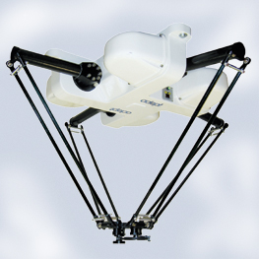
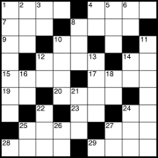
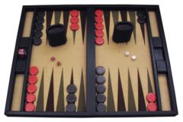
Environment Types
Part-Picking Robot
 | Crossword | Backgammon | Part-Picking Robot | Robot Taxi
Observable??
Deterministic??
Episodic??
Static??
Discrete??
Single-agent??

Slide 39
Environment Types
Fully vs. partially observable: an environment is fully observable when the sensors can detect all aspects that are relevant to the choice of action.
 | Crossword | Backgammon | Part-Picking Robot | Robot Taxi
Observable??
Deterministic??
Episodic??
Static??
Discrete??
Single-agent??
Notes:
Volledige observeerbare omgevingen zijn handig omdat de agent geen
Interne staat moet bijhouden over de omgeving
Partieel observeerbare omgevingen door noise of niet goed afgestelde sensoren of ontbrekende informatie

Slide 40
Environment Types
Fully vs. partially observable: an environment is fully observable when the sensors can detect all aspects that are relevant to the choice of action.
 | Crossword | Backgammon | Part-Picking Robot | Robot Taxi
Observable?? | FULL | FULL | PARTIAL | PARTIAL
Deterministic??
Episodic??
Static??
Discrete??
Single-agent??

Slide 41
Environment Types
Deterministic vs. stochastic: if the next environment state is completely determined by the current state and the executed action then the environment is deterministic
 | Crossword | Backgammon | Part-Picking Robot | Robot Taxi
Observable?? | FULL | FULL | PARTIAL | PARTIAL
Deterministic??
Episodic??
Static??
Discrete??
Single-agent??
Notes:
Als de omgeving gedeeltelijk observeerbaar is kan deze stochastisch lijken.
Dus het is beter om te kijken of de omgebing determinitisch of stochastisch is vanuit het standpunt van de agent.
Als de omgeving deterministisch is behalve de acties van de andere agenten dan is de omgeving strategisch.

Slide 42
Environment Types
Deterministic vs. stochastic: if the next environment state is completely determined by the current state and the executed action then the environment is deterministic
 | Crossword | Backgammon | Part-Picking Robot | Robot Taxi
Observable?? | FULL | FULL | PARTIAL | PARTIAL
Deterministic?? | YES | NO | NO | NO
Episodic??
Static??
Discrete??
Single-agent??

Slide 43
Environment Types
Episodic vs. sequential: In an episodic environment the agent’s experience can be divided into atomic steps where the agent perceives and then performs a single action. The choice of action depends only on the episode itself, not on previous actions/episodes & does not affect future actions or choices
 | Crossword | Backgammon | Part-Picking Robot | Robot Taxi
Observable?? | FULL | FULL | PARTIAL | PARTIAL
Deterministic?? | YES | NO | NO | NO
Episodic??
Static??
Discrete??
Single-agent??

Slide 44
Environment Types
Episodic vs. sequential: In an episodic environment the agent’s experience can be divided into atomic steps where the agent perceives and then performs a single action. The choice of action depends only on the episode itself, not on previous actions/episodes & does not affect future actions or choices
 | Crossword | Backgammon | Part-Picking Robot | Taxi
Observable?? | FULL | FULL | PARTIAL | PARTIAL
Deterministic?? | YES | NO | NO | NO
Episodic?? | NO | NO | YES | NO
Static??
Discrete??
Single-agent??
Notes:
May depend on level of granularity at which task is analyzed

Slide 45
Environment Types
Static vs. dynamic: If the environment can change while the agent is choosing an action, the environment is dynamic
 | Crossword | Backgammon | Part-Picking Robot | Robot Taxi
Observable?? | FULL | FULL | PARTIAL | PARTIAL
Deterministic?? | YES | NO | NO | NO
Episodic?? | NO | NO | YES | NO
Static??
Discrete??
Single-agent??
Notes:
If the agent performance score changes ahen time passes, the environment is semi-dynamic.

Slide 46
Environment Types
Static vs. dynamic: If the environment can change while the agent is choosing an action, the environment is dynamic
 | Crossword | Backgammon | Part-Picking Robot | Robot Taxi
Observable?? | FULL | FULL | PARTIAL | PARTIAL
Deterministic?? | YES | NO | NO | NO
Episodic?? | NO | NO | YES | NO
Static?? | YES | YES | NO | NO
Discrete??
Single-agent??
Notes:
If the agent performance score changes ahen time passes, the environment is semi-dynamic.

Slide 47
Environment Types
Discrete vs. continuous: This distinction can be applied to the state of the environment, the way time is handled and to the percepts/actions of the agent
 | Crossword | Backgammon | Part-Picking Robot | Robot Taxi
Observable?? | FULL | FULL | PARTIAL | PARTIAL
Deterministic?? | YES | NO | NO | NO
Episodic?? | NO | NO | YES | NO
Static?? | YES | YES | NO | NO
Discrete??
Single-agent??
Notes:
If the agent performance score changes ahen time passes, the environment is semi-dynamic.

Slide 48
Environment Types
Discrete vs. continuous: This distinction can be applied to the state of the environment, the way time is handled and to the percepts/actions of the agent
 | Crossword | Backgammon | Part-Picking Robot | Robot Taxi
Observable?? | FULL | FULL | PARTIAL | PARTIAL
Deterministic?? | YES | NO | NO | NO
Episodic?? | NO | NO | YES | NO
Static?? | YES | YES | NO | NO
Discrete?? | YES | YES | NO | NO
Single-agent??
Notes:
If the agent performance score changes ahen time passes, the environment is semi-dynamic.

Slide 49
Environment Types
Single vs. multi-agent: Does the environment contain more than one agent whose behavior interacts in some relevant way?
 | Crossword | Backgammon | Part-Picking Robot | Robot Taxi
Observable?? | FULL | FULL | PARTIAL | PARTIAL
Deterministic?? | YES | NO | NO | NO
Episodic?? | NO | NO | YES | NO
Static?? | YES | YES | NO | NO
Discrete?? | YES | YES | NO | NO
Single-agent??
Notes:
If the agent performance score changes ahen time passes, the environment is semi-dynamic.

Slide 50
Environment Types
Single vs. multi-agent: Does the environment contain more than one agent whose behavior interacts in some relevant way?
 | Crossword | Backgammon | Part-Picking Robot | Robot Taxi
Observable?? | FULL | FULL | PARTIAL | PARTIAL
Deterministic?? | YES | NO | NO | NO
Episodic?? | NO | NO | YES | NO
Static?? | YES | YES | NO | NO
Discrete?? | YES | YES | NO | NO
Single-agent?? | YES | NO | YES | NO
Notes:
If the agent performance score changes ahen time passes, the environment is semi-dynamic.

Slide 51
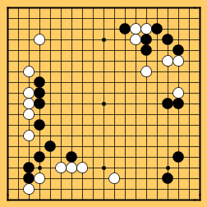
Environment Difficulty
The simplest environment is
Fully observable, deterministic, episodic, static, discrete and single-agent
Real world situations are frequently
Partially observable, stochastic, sequential, dynamic, continuous and multi-agent
Other factors that determine difficulty include
Difficulty of individual actions
E.g., Crosswords, part picking
Size/combinatorics of environment
E.g., The game of Go has ~3^{19*19} (= ~10¹⁷²) states

Slide 52
Agent Behavior in Environments
How does the inside of the agent work?
Agent = architecture + program
All agents types discussed here have the same skeleton:
Input = current percepts
Output = action(s)
Cognitive Cycle = generate output from input (and internal structure)

Slide 53
Agent Types
Four basic kinds of agent programs will be discussed:
Simple reflex agents
Model-based reflex agents
Goal-based agents
Utility-based agents
All can be turned into learning agents
A more complex variation
Hybrid agents

Slide 54
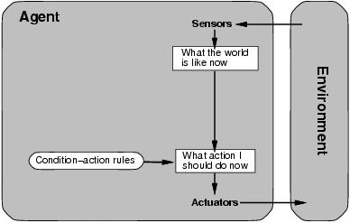
Simple Reflex Agent
Select action on the basis of only the current percept
Large reduction in possible percept/action situations (next slide)
May be implemented as condition-action rules
E.g., “If dirty then suck”

Slide 55
Simple Reflex Program in the Vacuum-Cleaner World
function REFLEX-VACUUM-AGENT ([location, status]) returns an action
if status = Dirty then return Suck
else if location = A then return Right
else if location = B then return Left
Reduction from 4^{T} to 3 entries
Notes:
4 is number of possible distinct percepts: A or B, clean or dirty

Slide 56
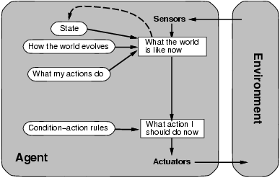
Model-Based Reflex Agent
To tackle partially observable environments
Maintain internal state representing best estimate of current world situation
Over time update state using world knowledge
How world changes
How actions affect world
⇒ Model of World

Slide 57
Model-Based Example
Suppose you are blind, but know that
Suck always cleans the current room
Left always leaves you in room A
Right always leaves you in room B
Totally unobservable world
Notes:
Move right: Update state that in room B
Suck: Update state that B is clean
Move left: Update state that in room A
Suck: Update state that A is clean

Slide 58
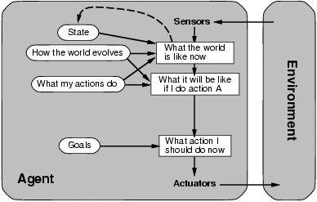
Goal-Based Agent
Goals describe what agent wants
By changing goals, can change what agent does in same situation
Combining models and goals enables determining which possible future paths could lead to goals
Typically investigated in search, problem solving and planning research

Slide 59
Goal Based Example
If goal is to clean both rooms
Suck
If goal is just to clean room B
Right

Slide 60
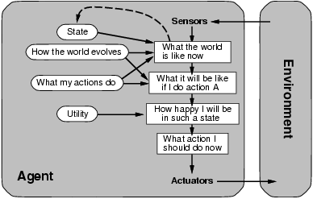
Utility-Based Agent
Some goals can be solved in different ways
Some solutions may be “better” – have higher utility
Utility function maps a (sequence of) state(s) onto a real number
Can think of goal achievement as 1 versus 0
Can help in optimization or in arbitration among goals or solutions

Slide 61
Summing Up
Key things to know:
What is an agent? What is an agent function?
What is a performance measure?
What is (and isn’t) rational behavior?
What is a task environment? What is PEAS?
What are the dimensions and descriptors to characterize a task environment? (fully vs. partially observable, single- vs. multi-agent, deterministic vs. stochastic, etc)
What kinds of agent programs are there? How are they different?

Slide 62
For next time…
Read Chapter 3 in AIMA “Solving Problems by Searching”
Practice problems:
Written Exercises:
from the textbook AIMA 3rd edition:
Chapter 1 Problem# 1.14
Chapter 2 Problem# 2.2, 2.5

